Slide 1
KPK Excise & Taxation system using Shibboleth
FYP-I Progress Presentation
Group Members
Umar Rizwan (15-6023)
Usman Ashraf (15-6016)
Subhan Ahmad (15-6118)
Supervised by
Mr. Fazle Basit
Evaluators
Dr. Muhammad Nauman
Dr. Usman Habib
1 of 13

Slide 2
KPK Excise & Taxation system using Shibboleth
FYP-I Progress Presentation
Outline
Background
Shibboleth
Model
Components Of Shibboleth
Service Provider (SP)
Identity Provider (IdP)
Discovery Service (DS)
Q&A Session
2 of 13

Slide 3
Background
Shibboleth
Model
Components Of Shibboleth
Q&A Session
KPK Excise & Taxation system using Shibboleth
FYP-I Progress Presentation
Background
The Excise department is engaged in collection of taxes.
They need their Token Taxation & Vehicle Transfer to be centralized.
Original district to be updated automatically.
3 of 13

Slide 4
Shibboleth
Background
Shibboleth
Model
Components Of Shibboleth
Q&A Session
KPK Excise & Taxation system using Shibboleth
FYP-I Progress Presentation
What?
Web Single Sign-On system
Separates authentication + authorization
Where?
Websites/web applications (+ mobile applications)
eJournals
4 of 13

Slide 5
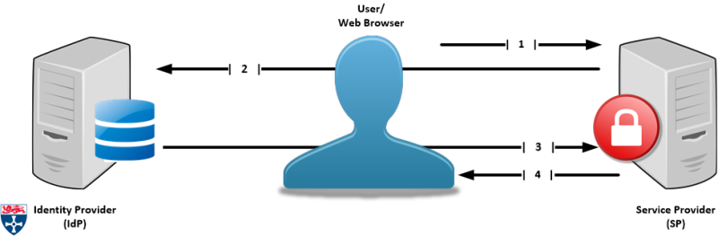
Terminology: Single Sign-on
Background
Shibboleth
Model
Components Of Shibboleth
Q&A Session
KPK Excise & Taxation system using Shibboleth
FYP-I Progress Presentation
It is an authentication process that allows the user to access multiple applications with one set of login credentials.
5 of 13

Slide 6
Authentication Authentication is the process of recognizing a user’s identity. Authorization Authorization is a security mechanism used to determine user/client privileges or access levels related to system resources
Background
Shibboleth
Model
Components Of Shibboleth
Q&A Session
KPK Excise & Taxation system using Shibboleth
FYP-I Progress Presentation
6 of 13

Slide 7
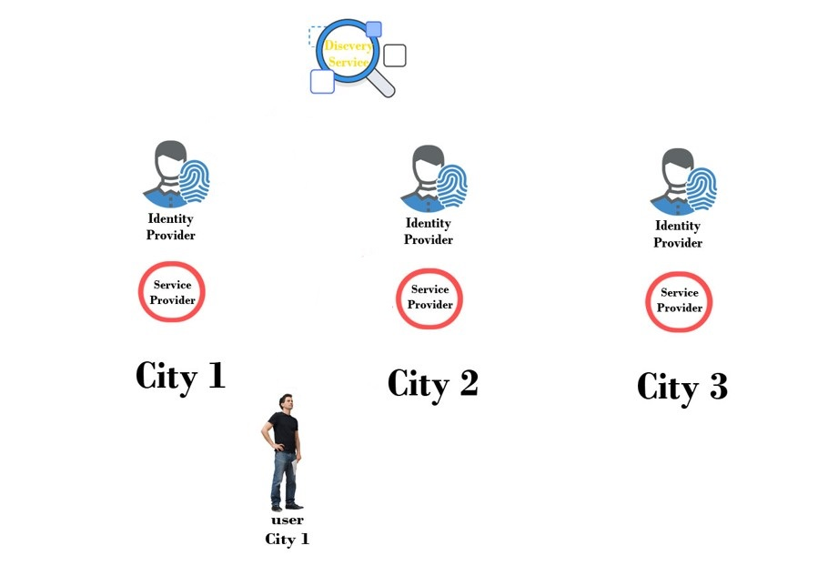
Background
Shibboleth
Model
Components Of Shibboleth
Q&A Session
KPK Excise & Taxation system using Shibboleth
FYP-I Progress Presentation
Model
3
2
4
1
5
7 of 13

Slide 8
Background
Shibboleth
Model
Components Of Shibboleth
Q&A Session
KPK Excise & Taxation system using Shibboleth
FYP-I Progress Presentation
Components Of Shibboleth
SAML
Shibboleth Identity Provider (IdP)
Shibboleth Service Provider (SP)
Shibboleth Discovery Service (DS)
8 of 13

Slide 9
Short DEMO
9 of 13

Slide 10
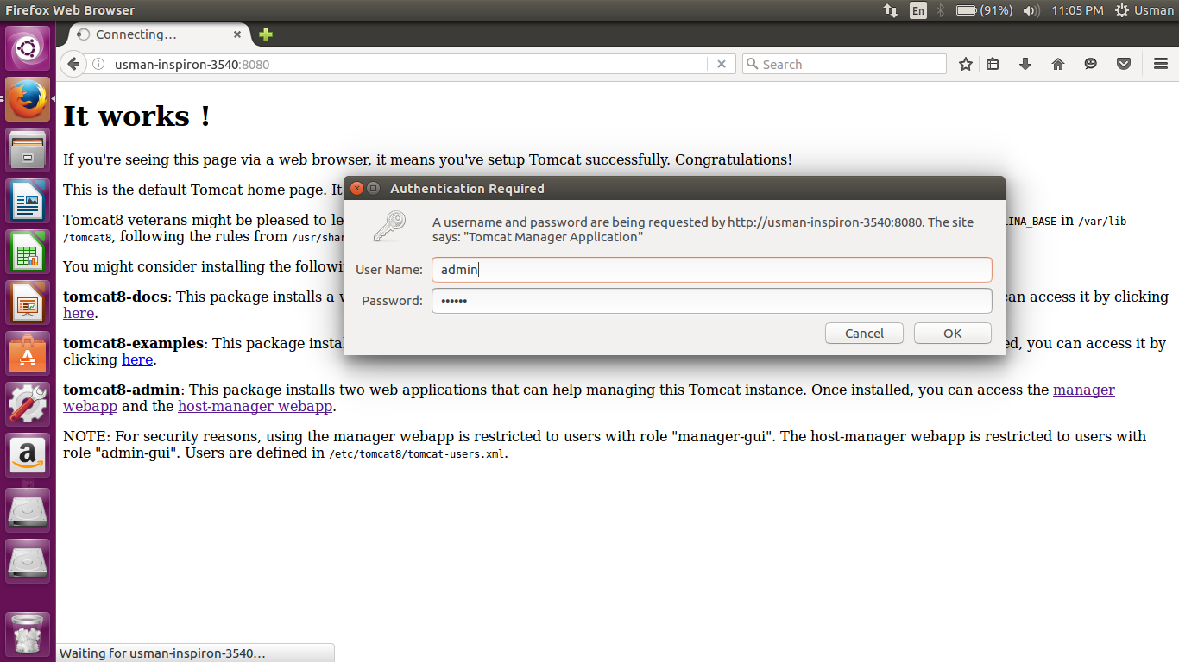

Slide 11
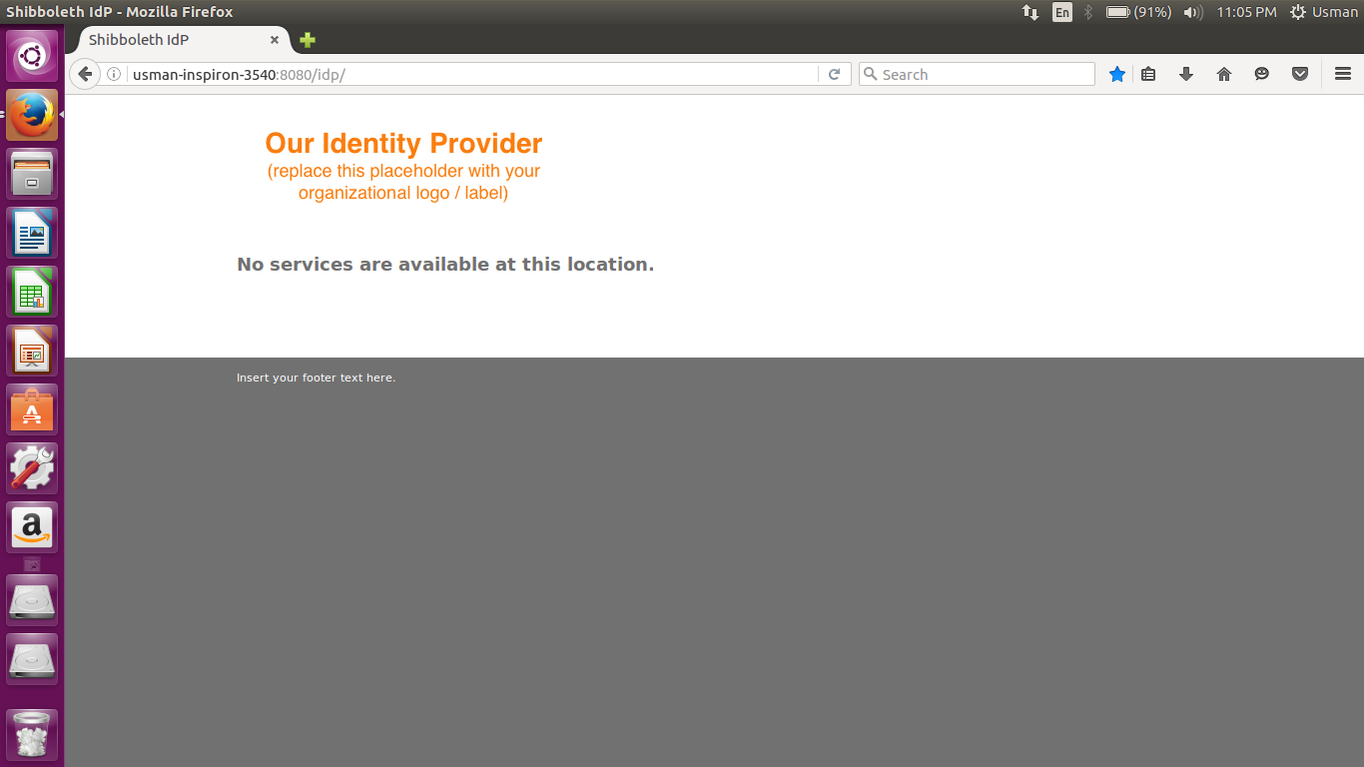

Slide 12
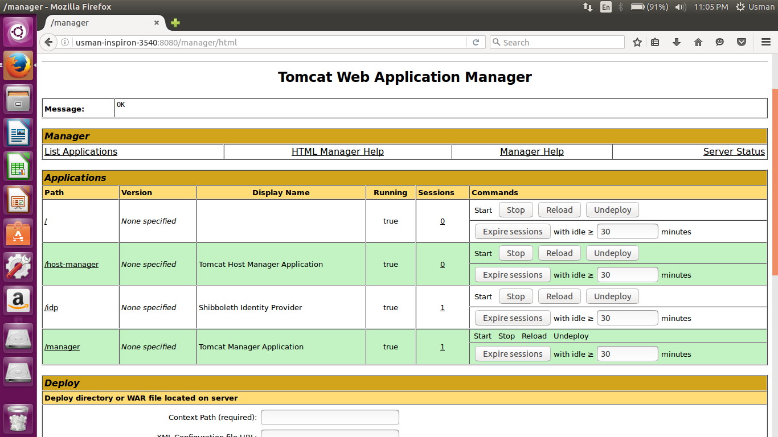

Slide 13
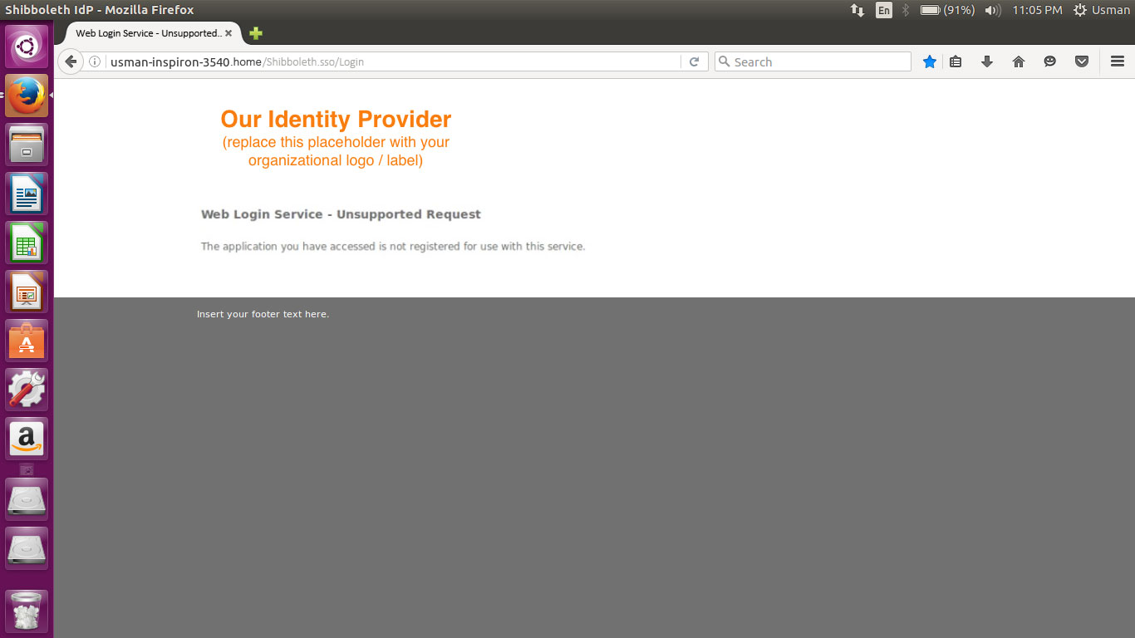

Slide 14
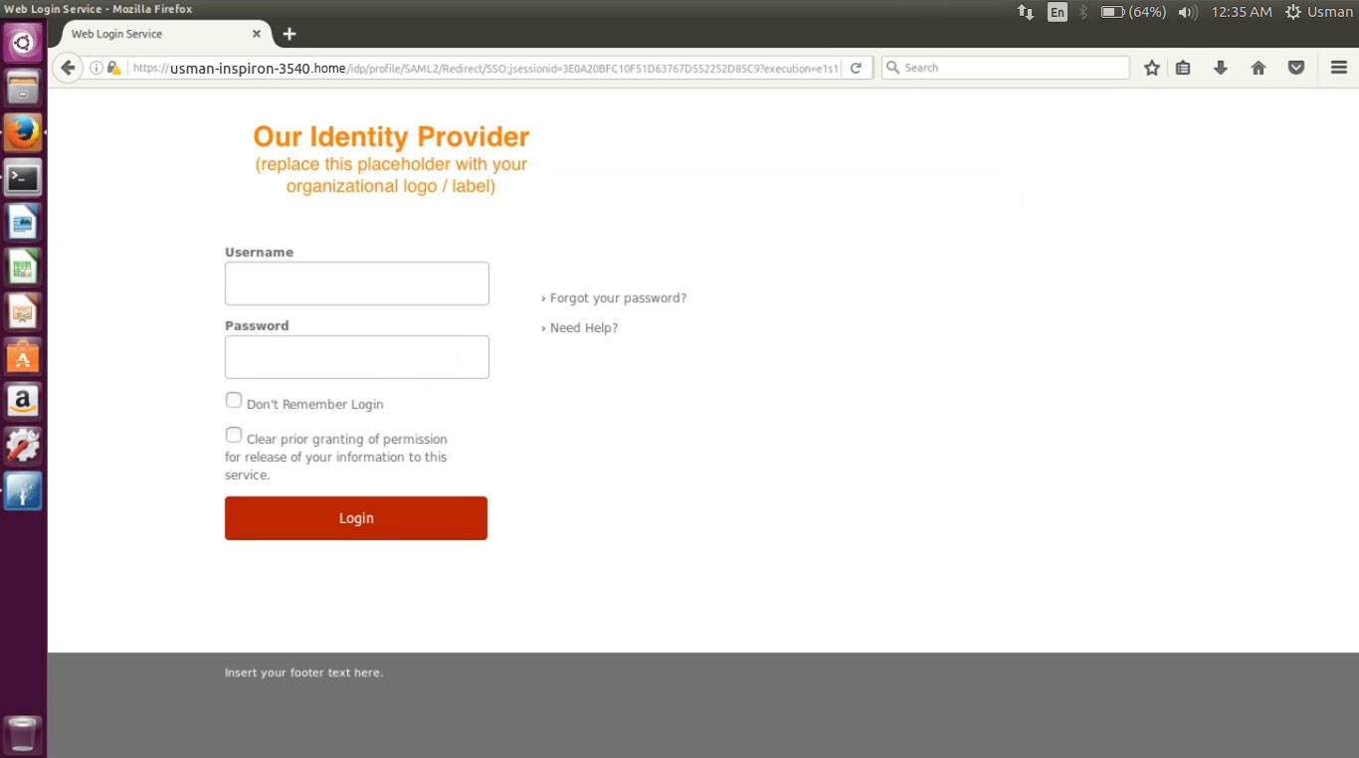

Slide 15
Identity Provider (IdP)
Background
Shibboleth
Model
Components Of Shibboleth
Q&A Session
Authenticates users and provides information about users (attributes)
Connects to existing authentication and user data systems
Provides information about a user that has been authenticated
10 of 13

Slide 16
Service Provider (SP)
Background
Shibboleth
Model
Components Of Shibboleth
Q&A Session
Typically initiates the request for authentication
Processes incoming authentication and attribute information (SAML assertion from IdP)
Optionally evaluates content access control rules
Passes user information (attributes) to web application
11 of 13

Slide 17
Discovery Service
Background
Shibboleth
Model
Components Of Shibboleth
Q&A Session
Tells the Service Provider which Identity Provider to use for authentication and attribute retrieval
Can be integrated into the web resource or used as a separate central service
Also known as Where Are You From (WAYF) service
12 of 13

Slide 18
Background
Shibboleth
Model
Components Of Shibboleth
Q&A Session
KPK Excise & Taxation system using Shibboleth
FYP-I Progress Presentation
Any Questions
Thank You!
13 of 13

